Slide 1
UML
By:- Group 6

Slide 2
List of Members of the group
Tripathi Aditya Prakash (Roll Number:5)
Nitin Kumar (Roll Number:7)
Anurag Rajpal (Roll Number:9)
Abhishek Kumar (Roll Number:11)
Abhijeet Pal (Roll Number:13)
Shubham Kumar Gupta(Roll Number:16)

Slide 3
Content
What do you mean by UML.
What are the uses of UML Diagram?
Explain different UML Diagram with example.

Slide 4
Section 1 : What do you mean by UML
UML stands for Unified Modeling Language. It's an international industry standard graphical notation used for describing, visualizing, constructing and documenting the artifacts of a software system.

Slide 5
Section 2 : What are the usage of UML Diagram?
To reason about system behavior.
To detect errors and omissions early in the life cycle.
To present proposed designs and communicate with stakeholders.
To understand requirements.
Use case diagram is used during the analysis phase of a project to identify the system functionality.
It describes the interaction of people or external device with the system under design.
It only summarizes some of the relationships between use cases, actors, and systems.
It has four elements need to be included in use case diagram.
They are actors, system, use case, and relationship.

Slide 6
Section 3:Different UML Diagrams
UML Use Case Diagram
UML Statechart Diagram
UML Activity Diagram
UML Class Diagram
UML Sequence Diagram
A
B
C
D
E

Slide 7
Section 3 a: Use case diagrams
They describe how a system functions from the user’s standpoint.
They present who may use what part of the system.
There are two parts of a use case diagram: the actor and the use case.
The actor represents the users of the system, including human and nonhuman entities.
The use case describes the services that actor can perform.
Content

Slide 8
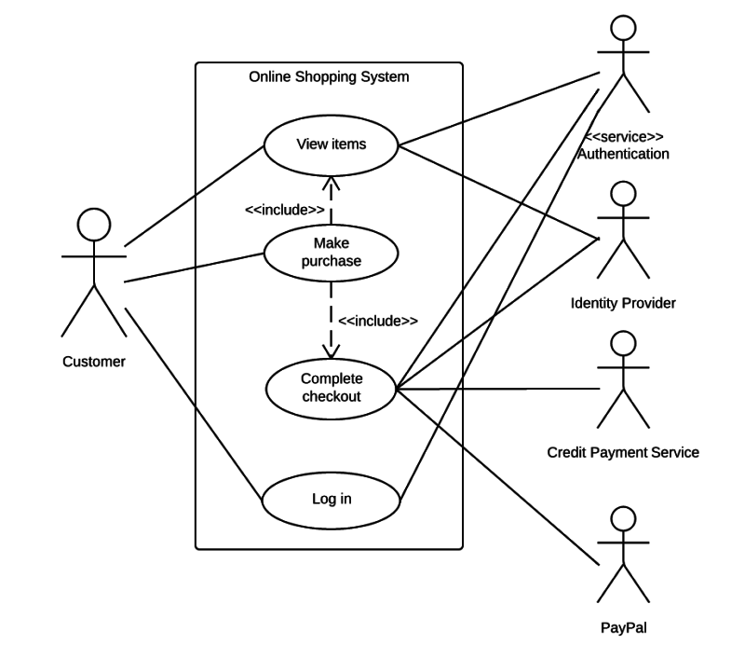
Section 3 a: Use case diagrams ..example
Content

Slide 9
Section 3 b: Use Class diagrams
Class diagrams graphically describe how a class functions.
A class is a collection of similar obhects.
Basically, they describe the data structure of the solution.
They describe the class, their attributes, and their operations.
Content

Slide 10
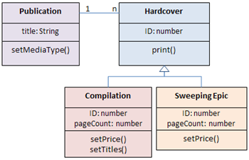
Section 3 b: Use class diagrams ..example
Content

Slide 11
Section 3 c: Use sequence diagrams ..example
Sequencing diagrams graphically present the interactivity between objects.
The interactions are represented as messages in the diagram.
The diagram shows the actions by the user and the subsequent actions that result between objects.
Content

Slide 12
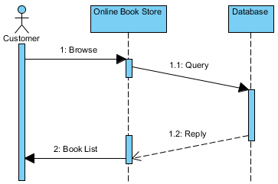
Section 3 c: Use sequence diagrams ..example

Slide 13
Section 3 d:Use statechart diagrams
A state diagram is a diagram used to describe the behavior of a system considering all the possible states of an object when an event occurs.
Each diagram represents objects and tracks the various states of these objects throughout the system.
Content

Slide 14
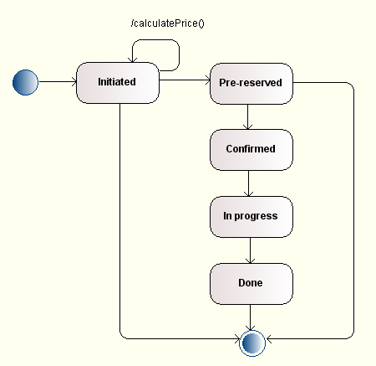
Section 3 d:Use statechart diagrams

Slide 15
Section 3 e:Use activity diagrams
An activity diagram describes the flow of activities.
This type of diagram is similar to a data flow chart.
It specifies what happens and when.
Content

Slide 16
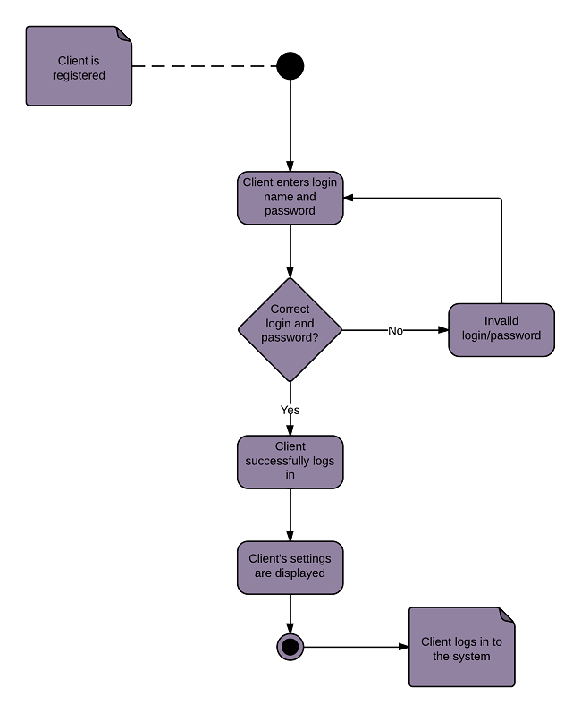
Section 3 e:Use activity diagrams

Slide 17


